Slide 1
Fiscal Training AU 2025
Alex Z, Peggy G

Slide 2
Spend Authorization
A Spend Authorization is required for all business travel and must be in “Approved” status prior to departure and before the purchase of any travel-related expense.
This applies even when there are no anticipated travel expenses or when a third party is paying for the travel expenses.
Only exception is when the destination is not greater than 45 miles from traveler’s work location and is one day only. If overnight lodging is required, an SA must be entered/approved.
Travel less than 45 miles from home is only eligible for mileage. Lodging and per diem is not an allowable expense per policy.
Spend Authorizations that do not include all estimated expenses, supporting documentation and/or are not compliant with all university policies that apply will not be approved and will be sent back to the traveler for edits.

Slide 3
Prior to starting a Spend Authorization (SA), you will need to compile a comprehensive list of the estimated expenses and supporting documentation.
Checklist:
Travel Dates and Location
  Conference/event agenda, program or letter of invitation
  If personal time will be included in travel, no expense(s) related to the personal time can be included in any of the expense item/spend authorization line cost estimates and a travel cost comparison form MUST be filled out and attached to the SA.
Airfare
  Obtain a list of current fares from Anthony travel by using the Concur online booking tool.
  If the traveler is adding personal time for the trip, then you must pull a second comparison quote to clearly show if there is any difference in the fare that would need to be paid for by the traveler.
    *Important* If the quote for the business eligible dates is less than the quote with the personal time added, then the traveler is required to pay the difference.
    Domestic and international flights less than 5 consecutive hours excluding layovers must be booked in coach class/economy.
Rental Car
  If you are using a rental car, you must use our contracted vendors, Enterprise, National, or Hertz. You will need to mention the OSU contract so that the proper insurances are included. Do not pay additional insurances or damage waivers. A quote can be obtained on the Concur website. https://busfin.osu.edu/buy-schedule-travel/travel
Lodging
  A quote, screenshot or other appropriate documentation should be included to support the lodging amount entered.
  When possible, lodging should be shared with another OSU traveler (for students).
  When the room is being shared with another OSU traveler, the name and SA# should be documented on both SAs to facilitate the review process and avoid delays.

Slide 4
  Rideshare/Taxi
    Expense line memo should state purpose for ride, i.e. airport to home, hotel to conference, etc.
  Per diem
    For the spend authorization expense line, select pre trip per diem.
    Only include the business eligible dates when estimating per diem.
    If per diem is not being requested for any reason, please add a comment to explain.
  Conference Registration
    A quote, screenshot or other appropriate documentation should be included to support the amount entered.
  Miscellaneous Items
    Baggage Fees
    Incidentals
    Please verify that the amounts entered on the SA match the back-up documentation and if there are variances, they are clearly explained.
  Driving versus Flying
    There are forms need completed: travel comparison form, a flight estimate, and a mileage log
      Must show the cost difference for driving. If the cost to drive is more expensive, the traveler is responsible for the difference. At time of reimbursement, your reimbursement will be reduced to reflect the difference in costs.
      A rental car price comparison is also required if using your personal vehicle.
      Travel comparison form must be attached to the spend authorization as well along with the flight, mileage, and rental car estimates.
      Link to comp form

Slide 5
Quick Notes/Tips
Every spend authorization needs 5 things:
Who: Person traveling
What: Type of event (conference, meeting, training, etc.)
Where: Location of event being attended
When: Date of event and travel days
Why: Purpose of attending event
Every spend authorization needs detailed expense lines:
Mode of transportation: how will you get to your destination.
Lodging: where will you sleep
Ground transportation: how will you get around while at the event.
Meals: what/how will you eat (per diem)
Conference fee
Justification vs. Description Fields:
Justification Field needs to be fully detailed with the Who, What, When, Where and Why along with any other important detail
  Example: Brutus Buckeye to attend AERA in San Diego, CA on April 22-25, 2022 to support professional development, networking and collaboration efforts on behalf of FST
Description field should be a short, condensed description of what the spend authorization is for:
  Example: Chips and Dips Conference February 30, 2030, in Tuscaloosa, AL.

Slide 6

Entering a Spend Authorization

Slide 7
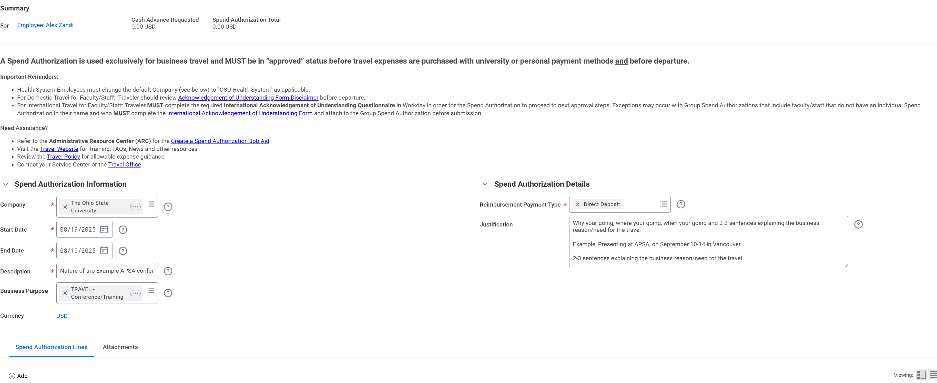

Slide 8
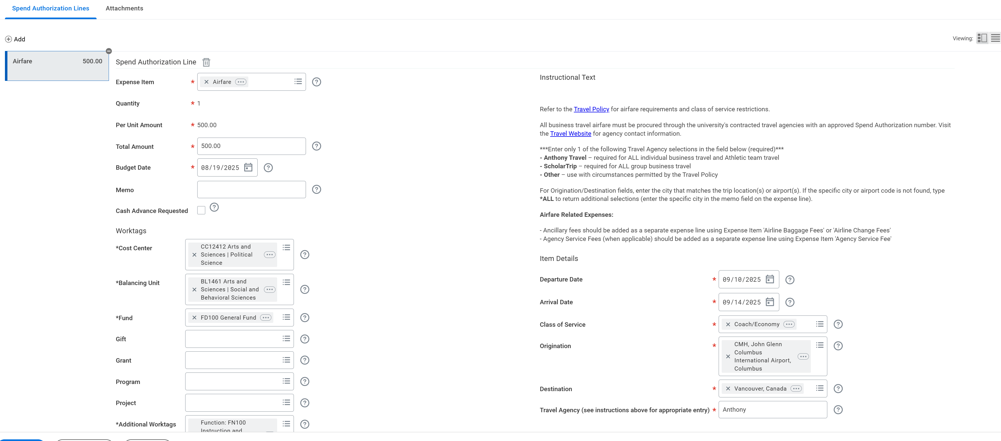
Worktags can be obtained from Alex or Peggy. Funding must be available to cover costs

Slide 9
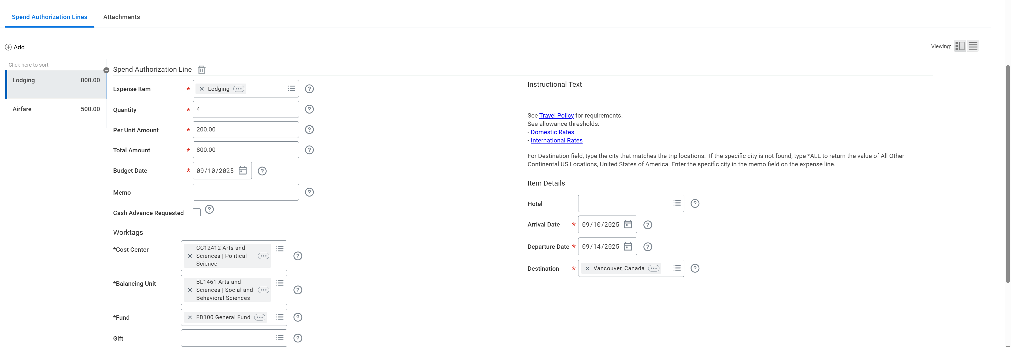

Slide 10
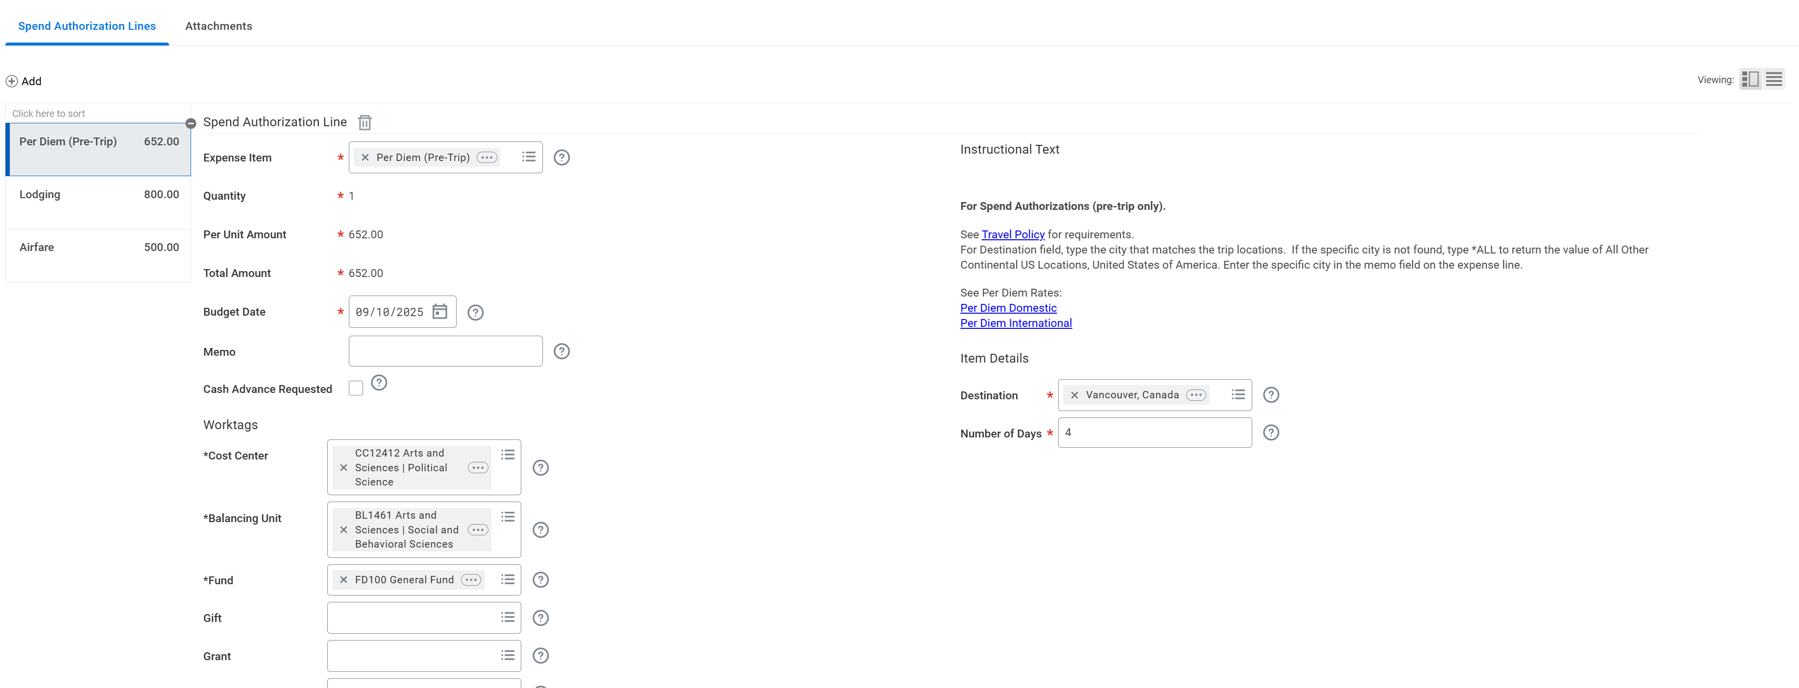

Slide 11
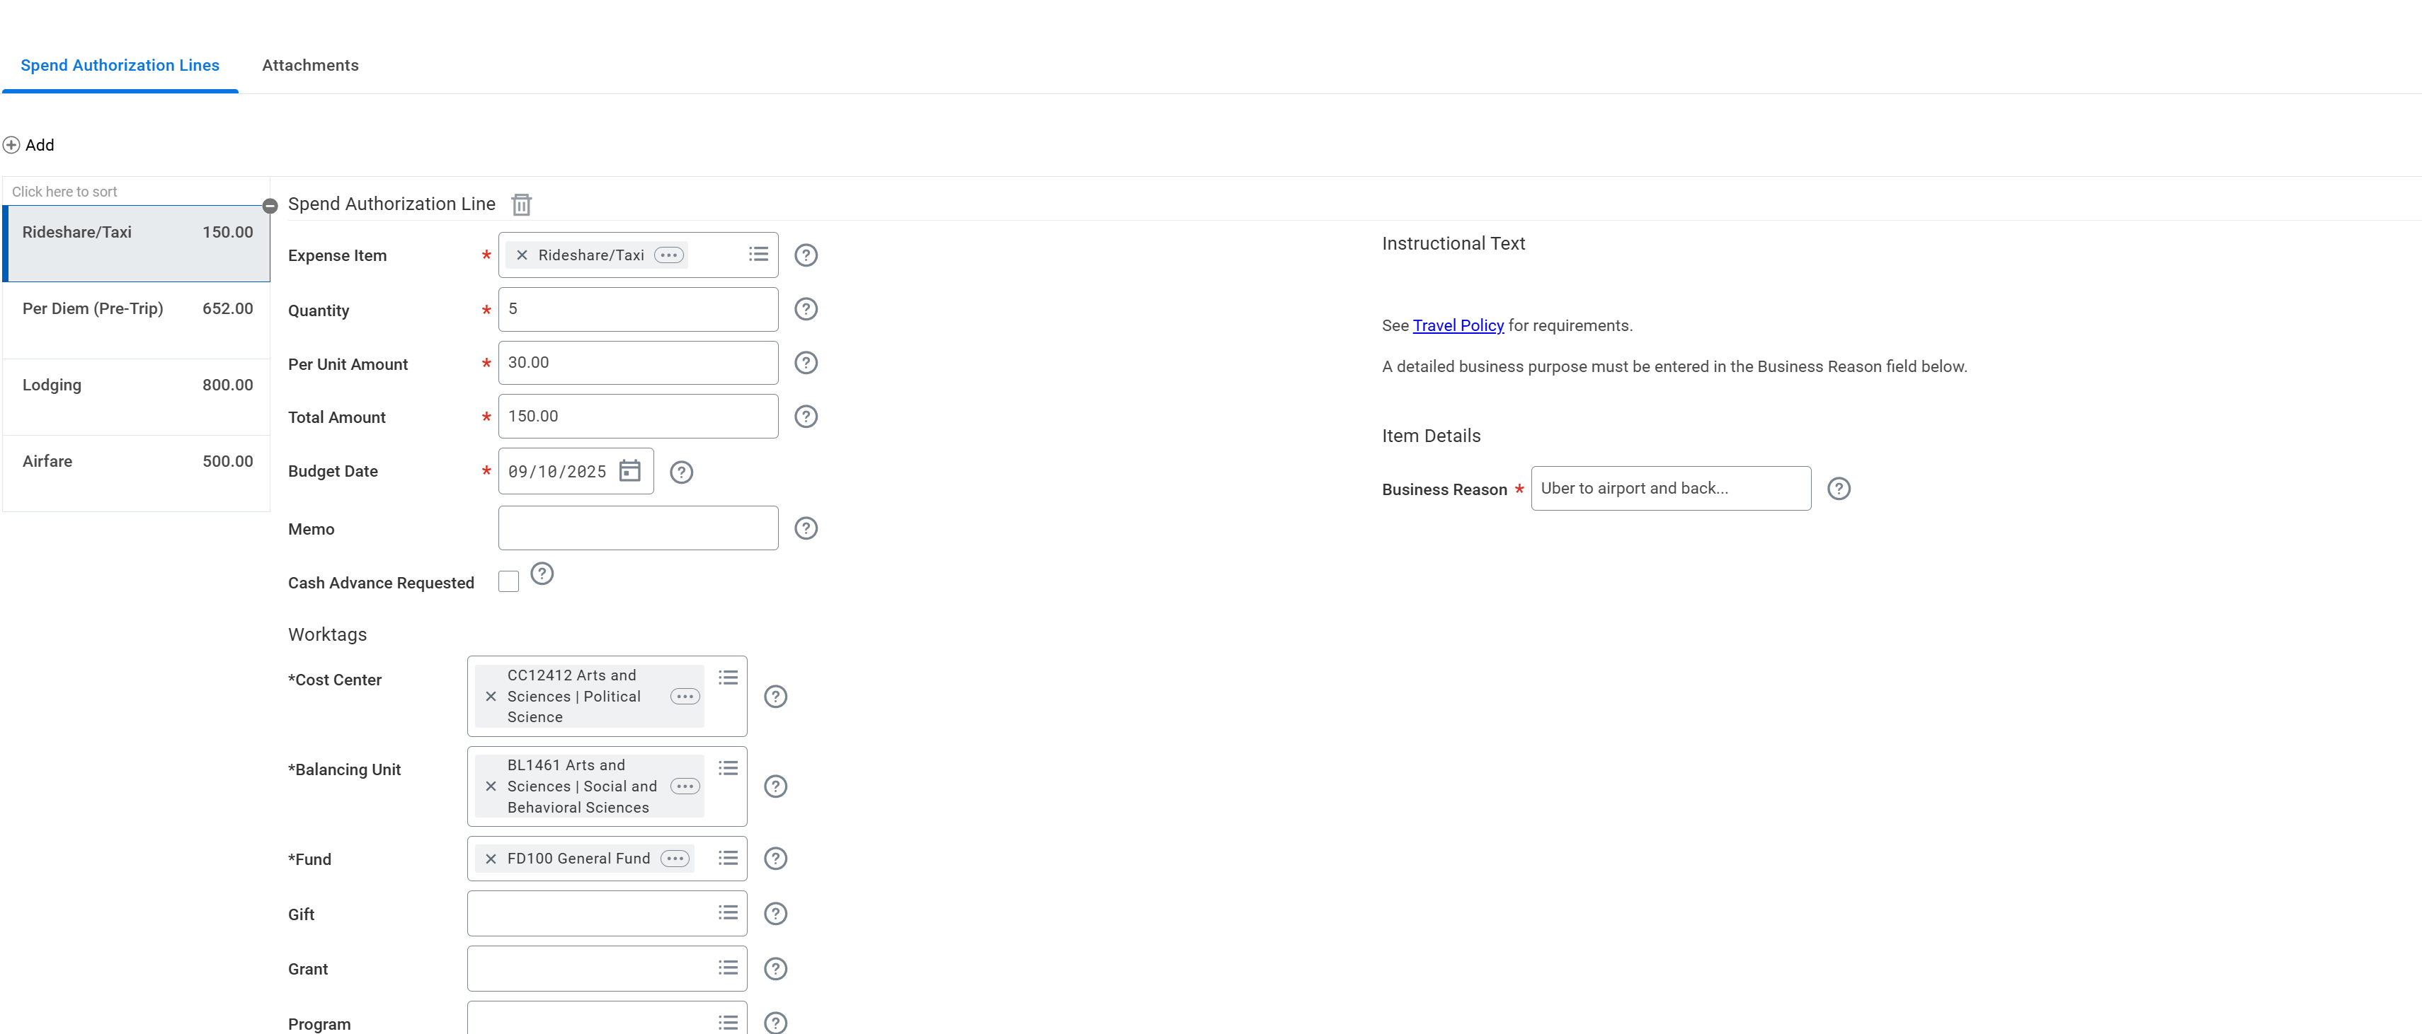

Slide 12
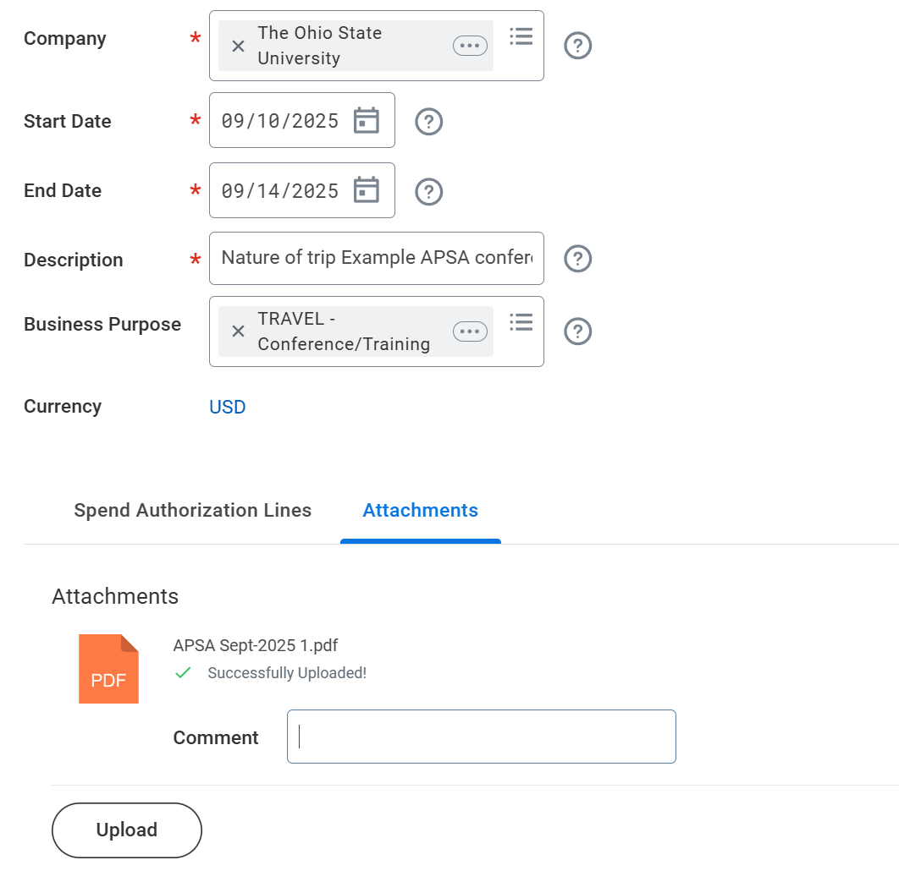

Slide 13
Entering an Expense report
  Expense report: An expense report is a form that itemizes expenses to be reimbursed when an employee incurs business expenses.
Travel expenses need the following elements for approval:
  Your expense report must reflect your spend authorization, meaning expense lines and dollar amounts on the ER should be as close as possible to the SA for reimbursement.
  Itemized receipts are required for every expense except for meals and when mileage is involved.
    Unless you are specifically told to track your meal expenses per diem will be paid out at a fixed rate that workday will automatically calculate
    If receipt is in a non-USD currency, please include your bank statement showing your name and the converted amount. Please remember to only include the last 4 digits of the card number.
    If you are driving a rental car or personal car you MUST complete a travel comp form BEFORE the trip
  Your funding must match what you used on the spend authorization.
    Example: If you used a grant for funding for lodging, you need to use the same grant for funding on your expense report. It does not carry over from the SA to the expense report. Funding must be entered on the expense report.

Slide 14
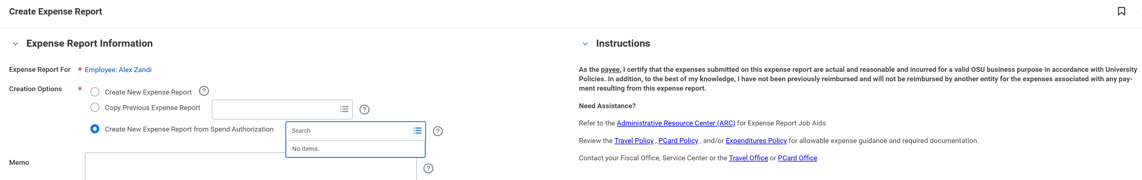
Search create expense report

Slide 15
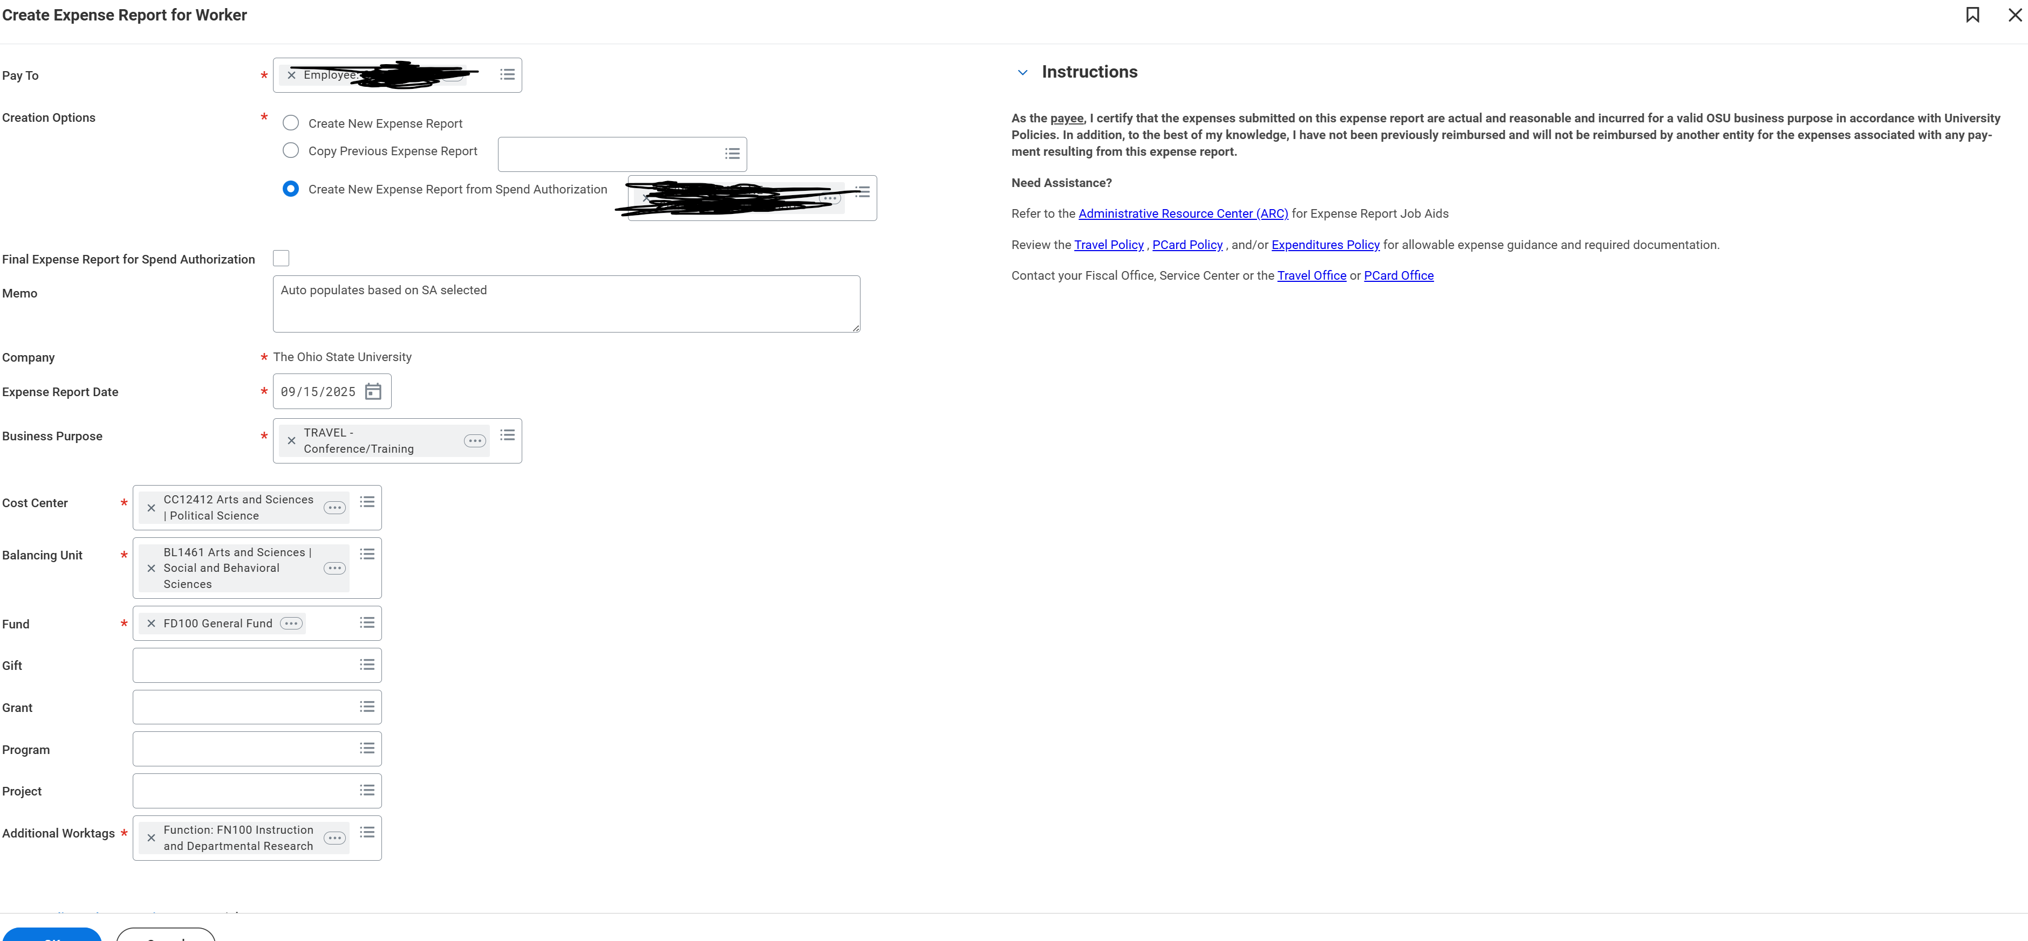
If this is your last reimbursement, check this box. This closes the SA
View your approved spend authorization and enter the worktags from the SA.

Slide 16
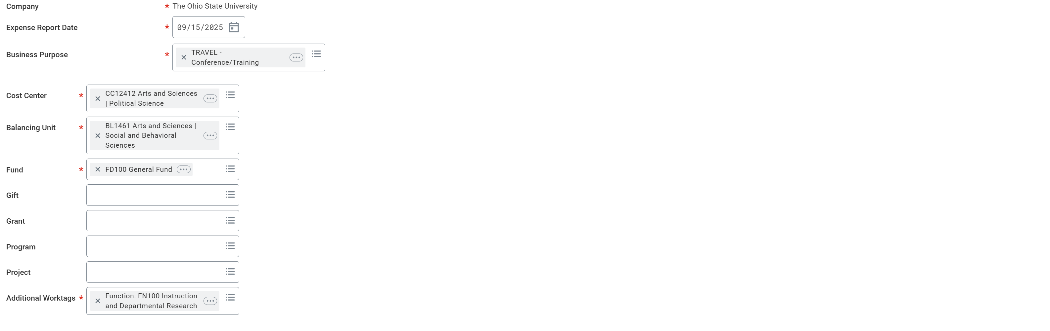

Slide 17
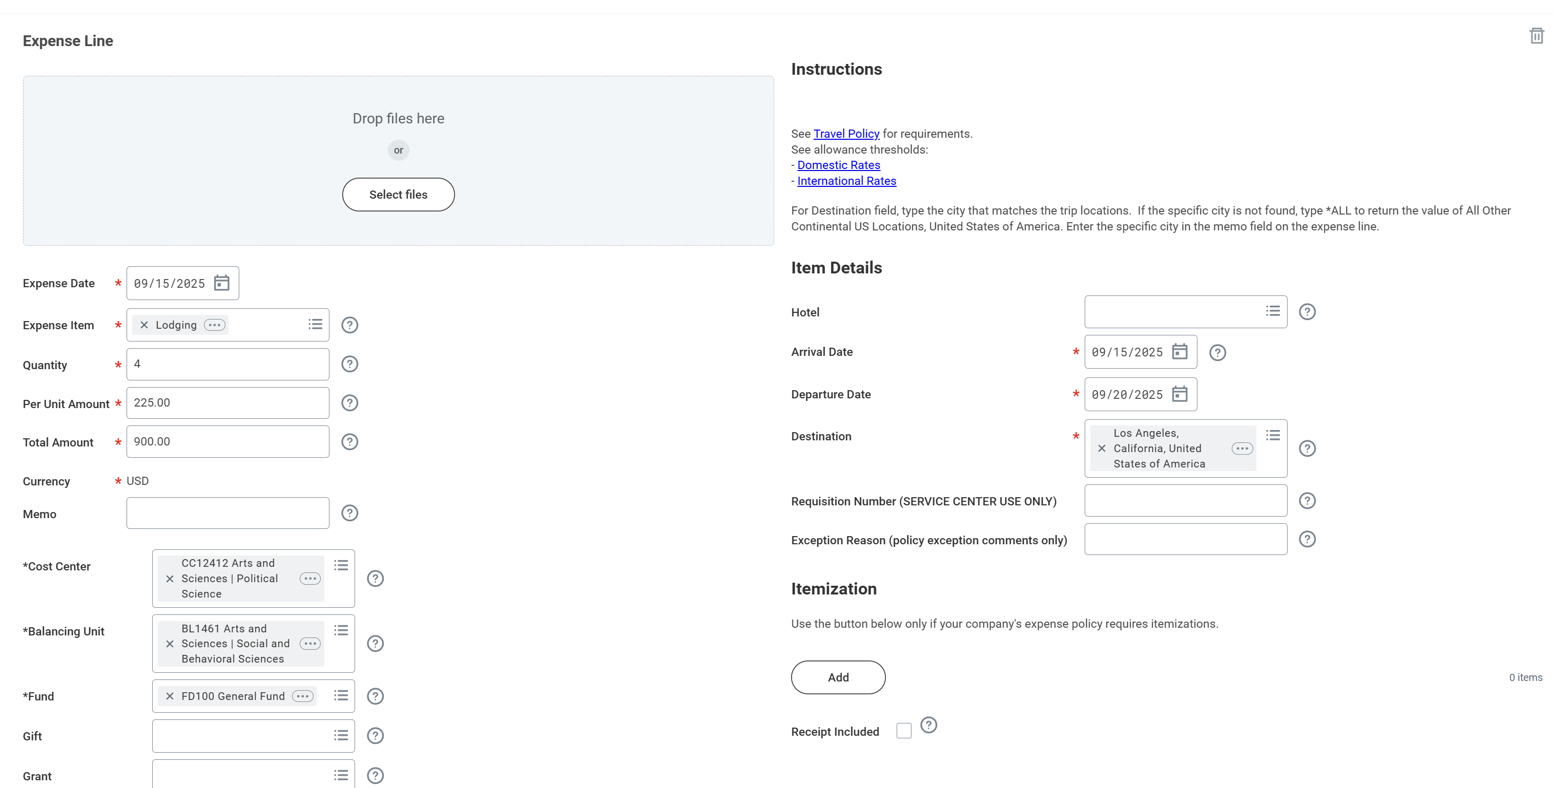

Slide 18
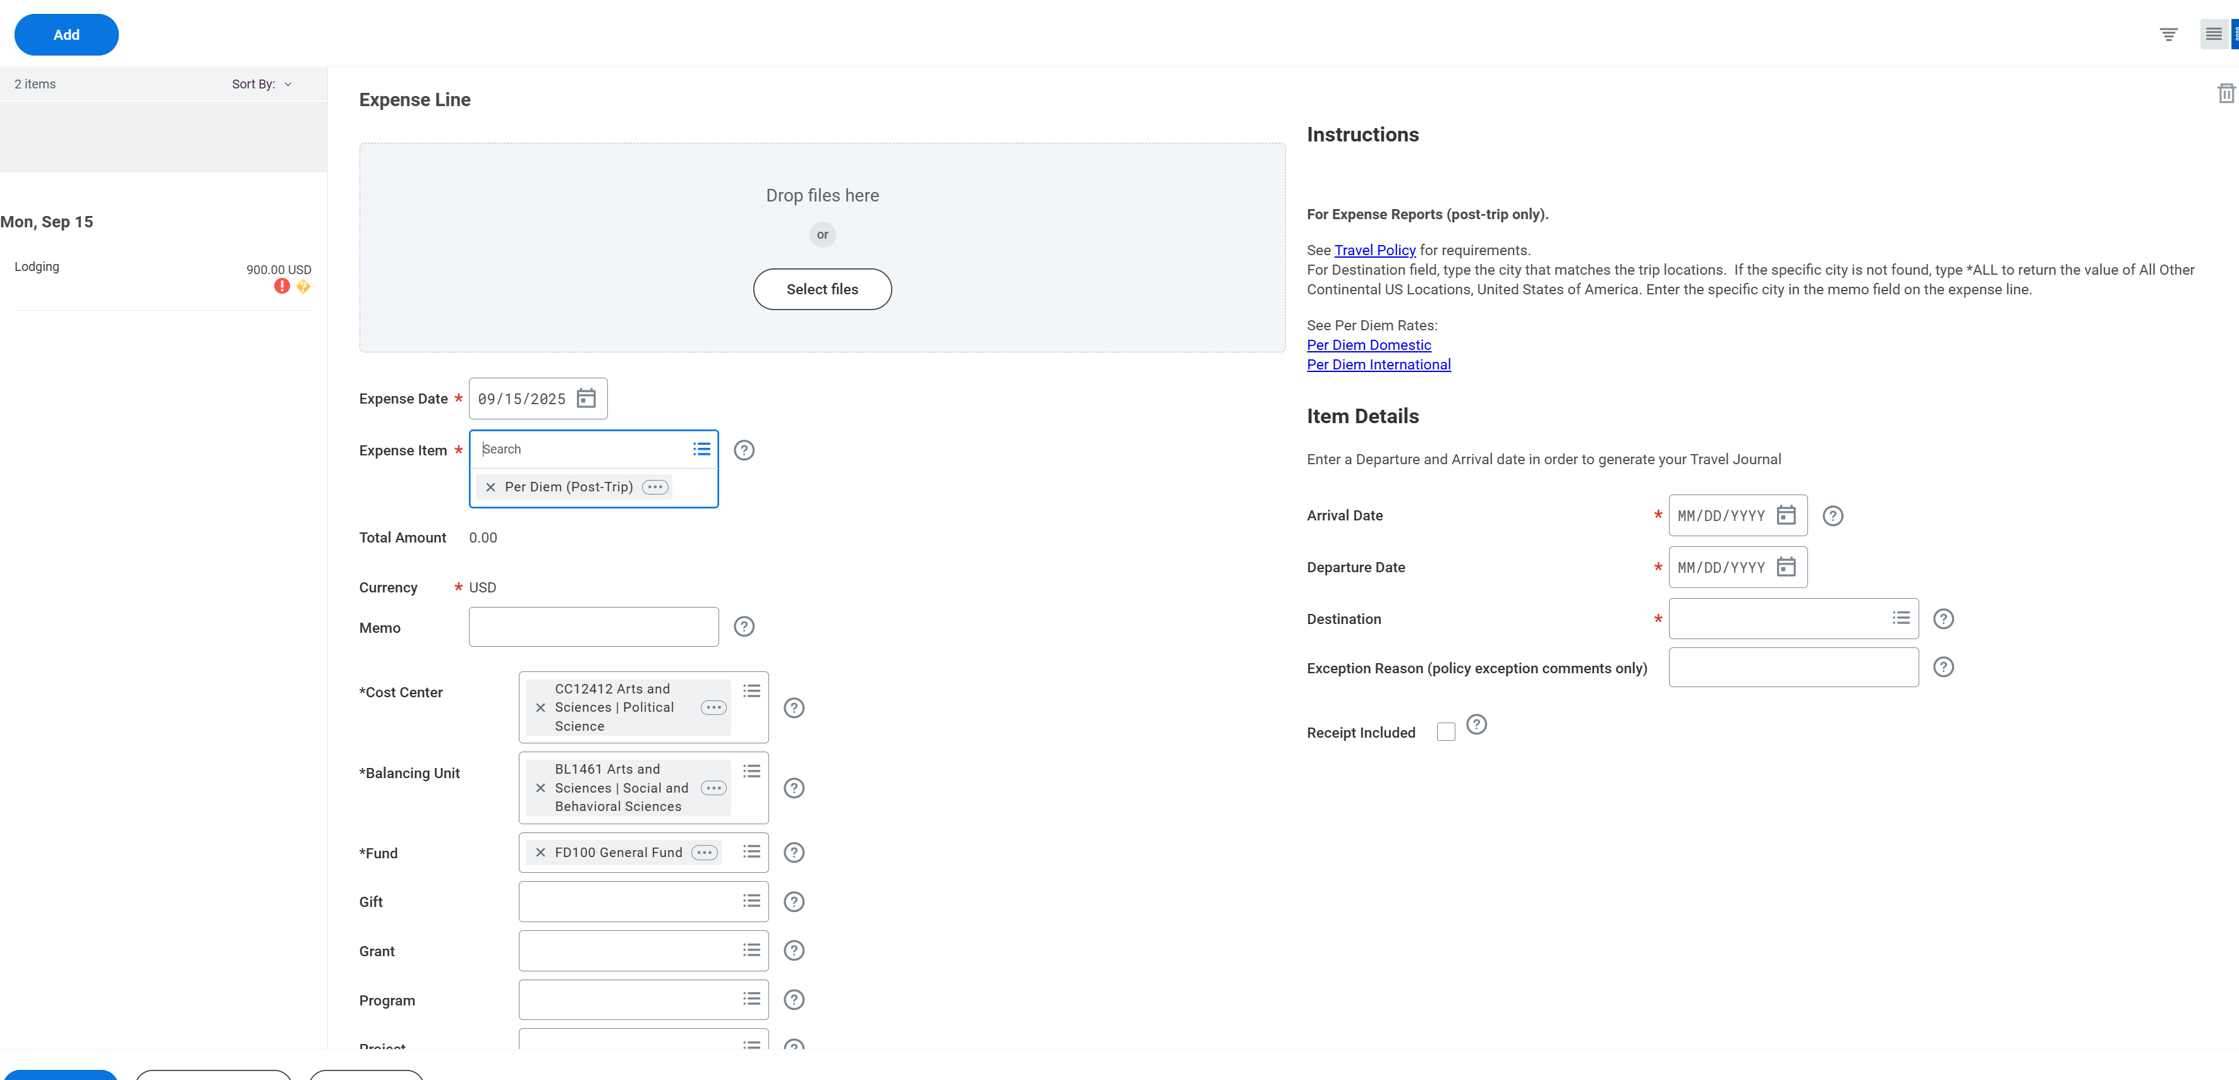

Slide 19
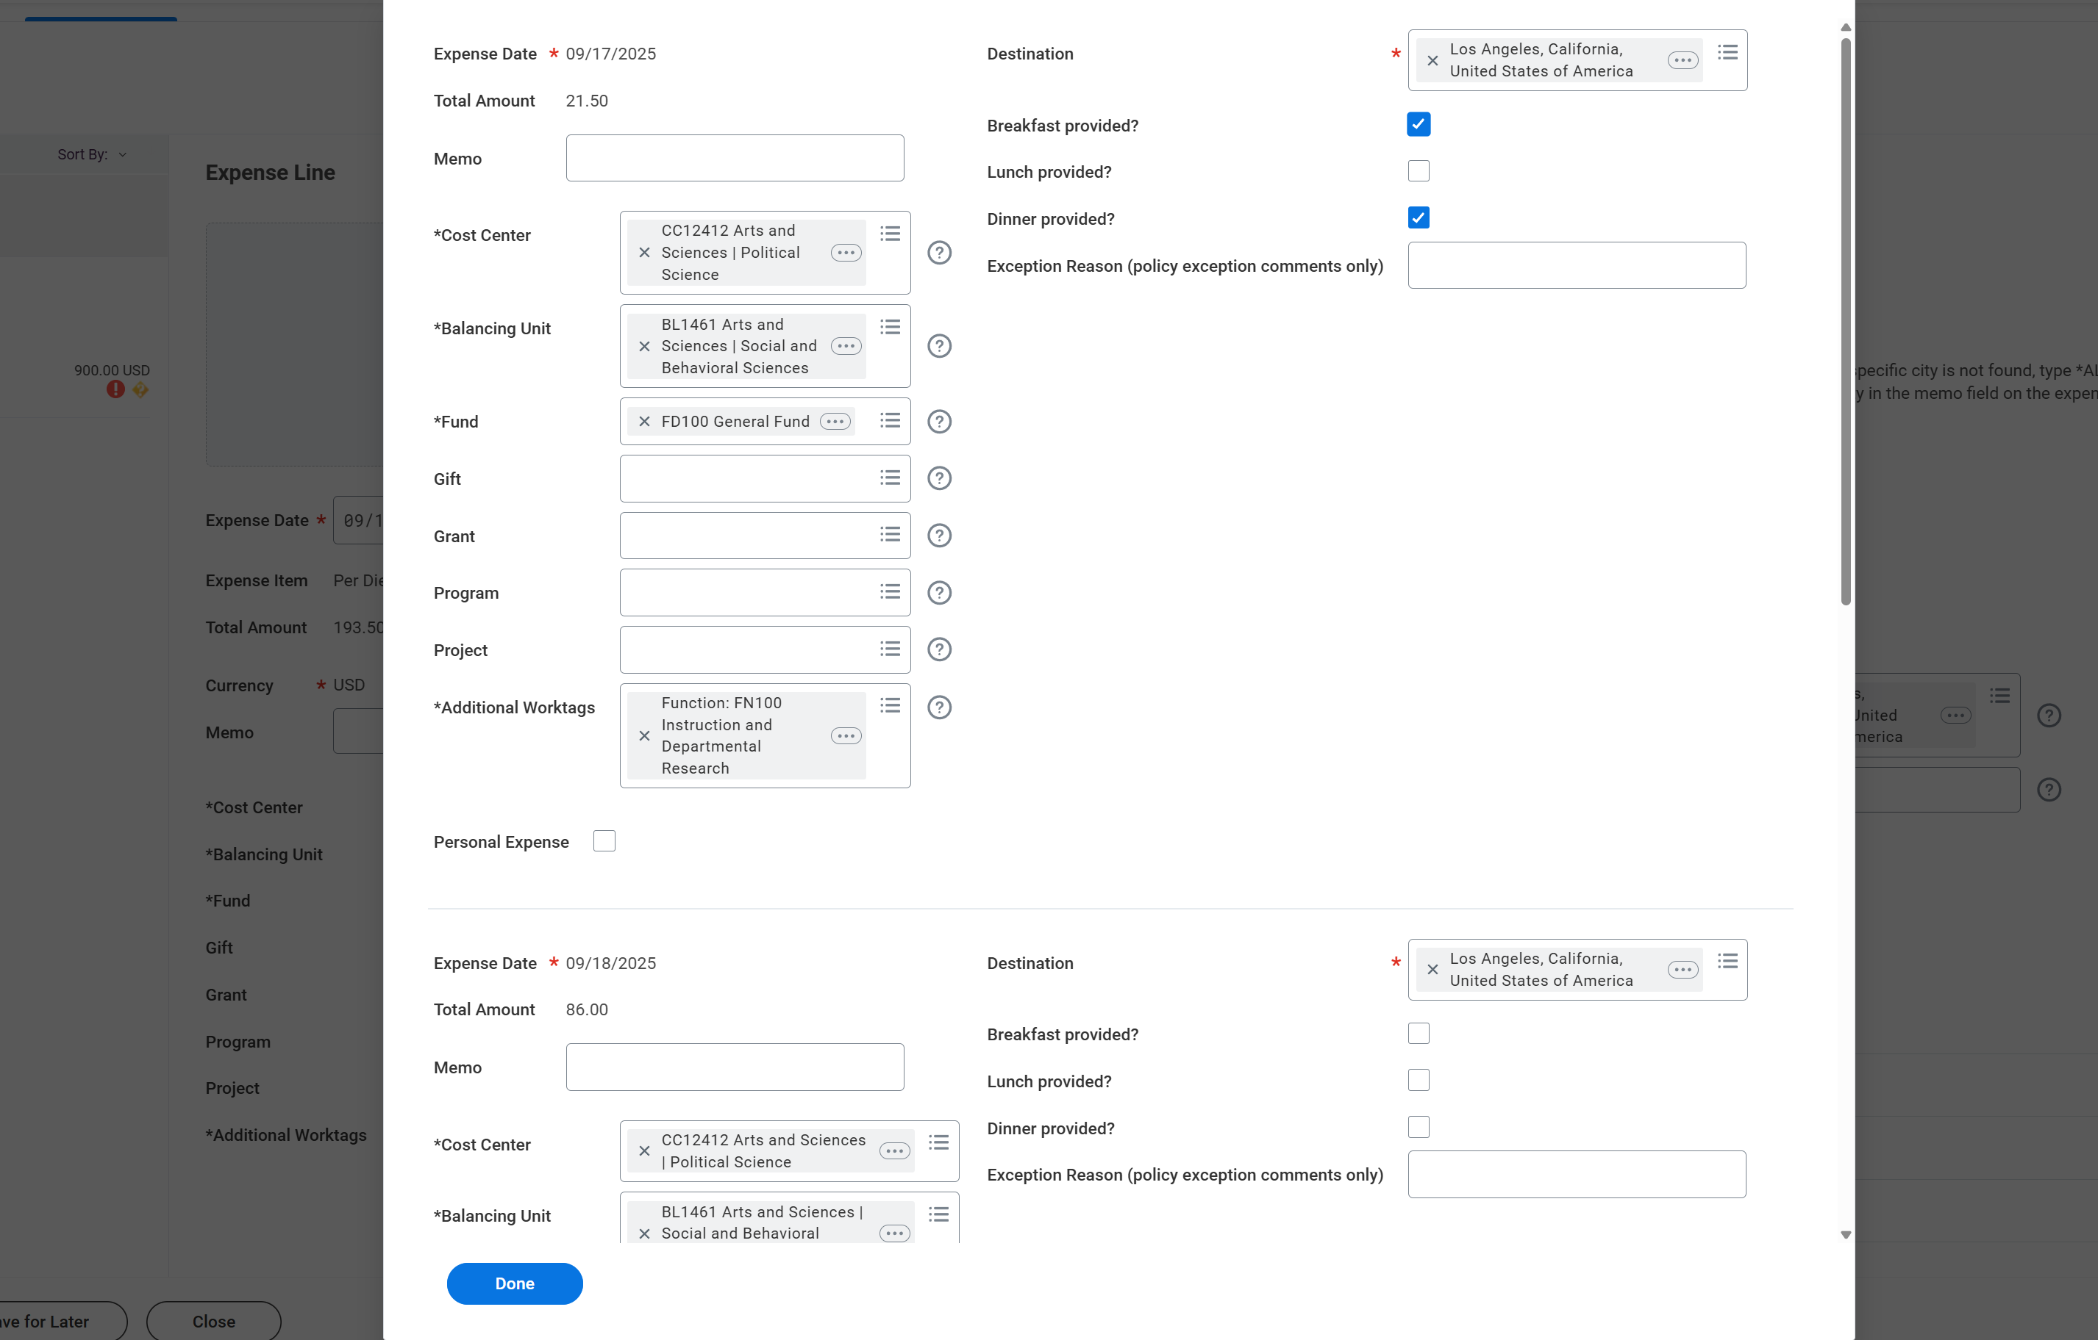
For meals provided, place a check in the box. This could be breakfast included in lodging or meals provided by conference.

